Slide 1
UnifyNFT: A Unified Platform for NFT-Backed Lending
GROUP 38
21/05/2025

Slide 2
01
Background
CON
TENT
02
Company Introduction
03
Technology Product
04
Innovation Concepts

Slide 3
01
Background

Slide 4
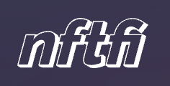

Background
NFTs
financial services
NFT lending market is highly fragmented.
Major Problem
It’s hard to compare your options, and you can’t easily switch between institutional and P2P models.
Limits access to credit, especially for NFT holders who don’t fit neatly into one category.
(NFTfi, n.d.)
peer-to-peer and decentralized
Users: don’t get the best rates, feel confused by overly technical systems.
Companies: struggle to scale, locked into one user group (crypto-native or TradFi )
Real Demand: a unified platform that lowers entry barriers, improves decision-making, and connects both sides of the NFT lending ecosystem
(Figure, n.d.)
fully regulated services for institutions

Slide 5
02
Company Introduction

Slide 6
Company and Industry Introduction
UnifyNFT
Our Company
Goal: Connect users, improve access, and unify innovation in NFT lending
A unified lending platform: allows users to borrow and lend crypto assets using NFTs as collateral
Bridge both ends of the market—peer-to-peer and institutional lending—in one place.
Main User Groups
NFT holders looking for fair loan terms
Crypto-native lenders seeking better tools
Financial institutions that need regulatory control and infrastructure access
NFT finance industry
Broader DeFi ecosystem: Fast-growing but fragmented.
Huge potential but lacks clarity and accessibility.
NFT-backed loans: risky, technical, limited to niche users.
Function
Bring together offerings from both decentralized lenders and licensed institutions.
Give flexibility to compare rates, choose who to borrow from, and unlock the full financial value of their NFTs.

Slide 7
03
Technology Product

Slide 8
Bridging DeFi and Traditional Finance
单击此处添加标题文本内容
P2P Lending (NFTfi-like)
(NFTfi n.d.)
Institutional Lending (Figure-like)
(Figure 2023)
Supports ERC-721 / ERC-1155
+
Smart contract automation
01
03
UnifyNFT
Single platform, dual-entry access
KYC/AML, credit risk layers for compliant institutional lending
02

Slide 9
NFT Lending in 4 Simple Steps
01
02
03
04
Connect Wallet
Upload NFT
View P2P & Institutional Offers
Accept Offer & Get Funds

Slide 10
Tech Principles Behind the Platform
1
Interoperability
Multi-chain & token standard support
UnifyNFT
One platform,
two lending
worlds
2
Security
Audited smart contracts, role-based access
Scalability
Open APIs and SDKs for dev & partners
3

Slide 11
4.1
Distributed Innovation concepts

Slide 12
Open Innovation – Outside-in
Using the protocol that was using by most user. Do not make customer learn new thing, easier acceptance.
Distributed
Innovation concepts
Web APIs
Allowing both individual and cooperative company freely using APIs
Platform Ecosystem
We play platform owners role. Intermediary Platform
Crowd Lending

Slide 13
4.2
Dominant category / Dominant designs

Slide 14
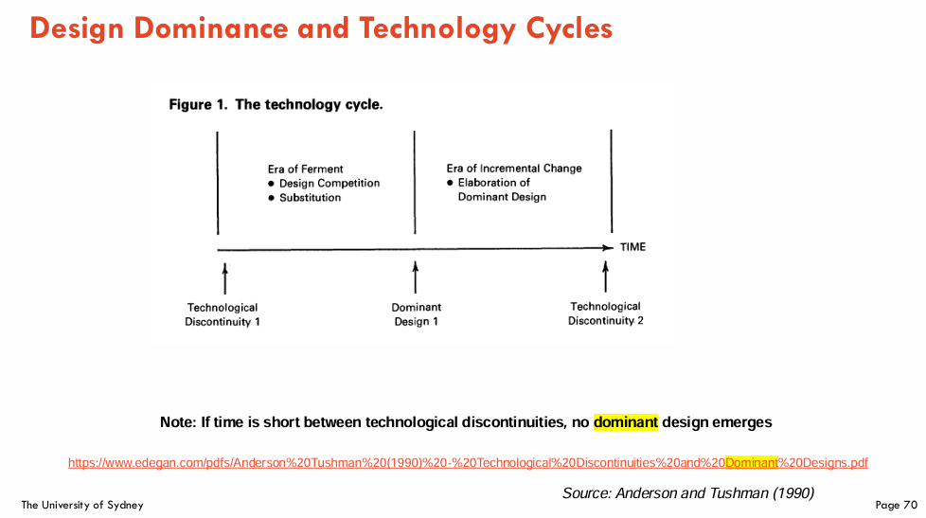
(Ullah, 2025)
Before the Dominant Design 1 phase, so have chance
Open architecture for NFT Protocols, such as ERC-721 and ERC-1155
Better customer user experiences.

Slide 15
4.3
Disruptive Innovation

Slide 16
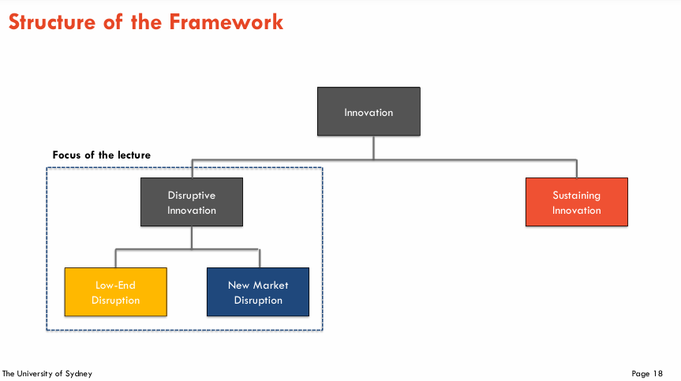
(Ullah, 2025)
New Market Disruption
needs that were not being addressed by existing products
Both individual and company can become loan lender

Slide 17
4.4
Value-Chain

Slide 18
Capital
Lenders/ Funds, Loan-NFT trading
Match & Escrow
P2P / Regulated loans, Smart-contract vault
Collateral Verification
Ownership proof,
Floor-price oracle
NFT Creation & Listing
Creators, Marketplaces

Slide 19
4.5
Business Model Canvas

Slide 20
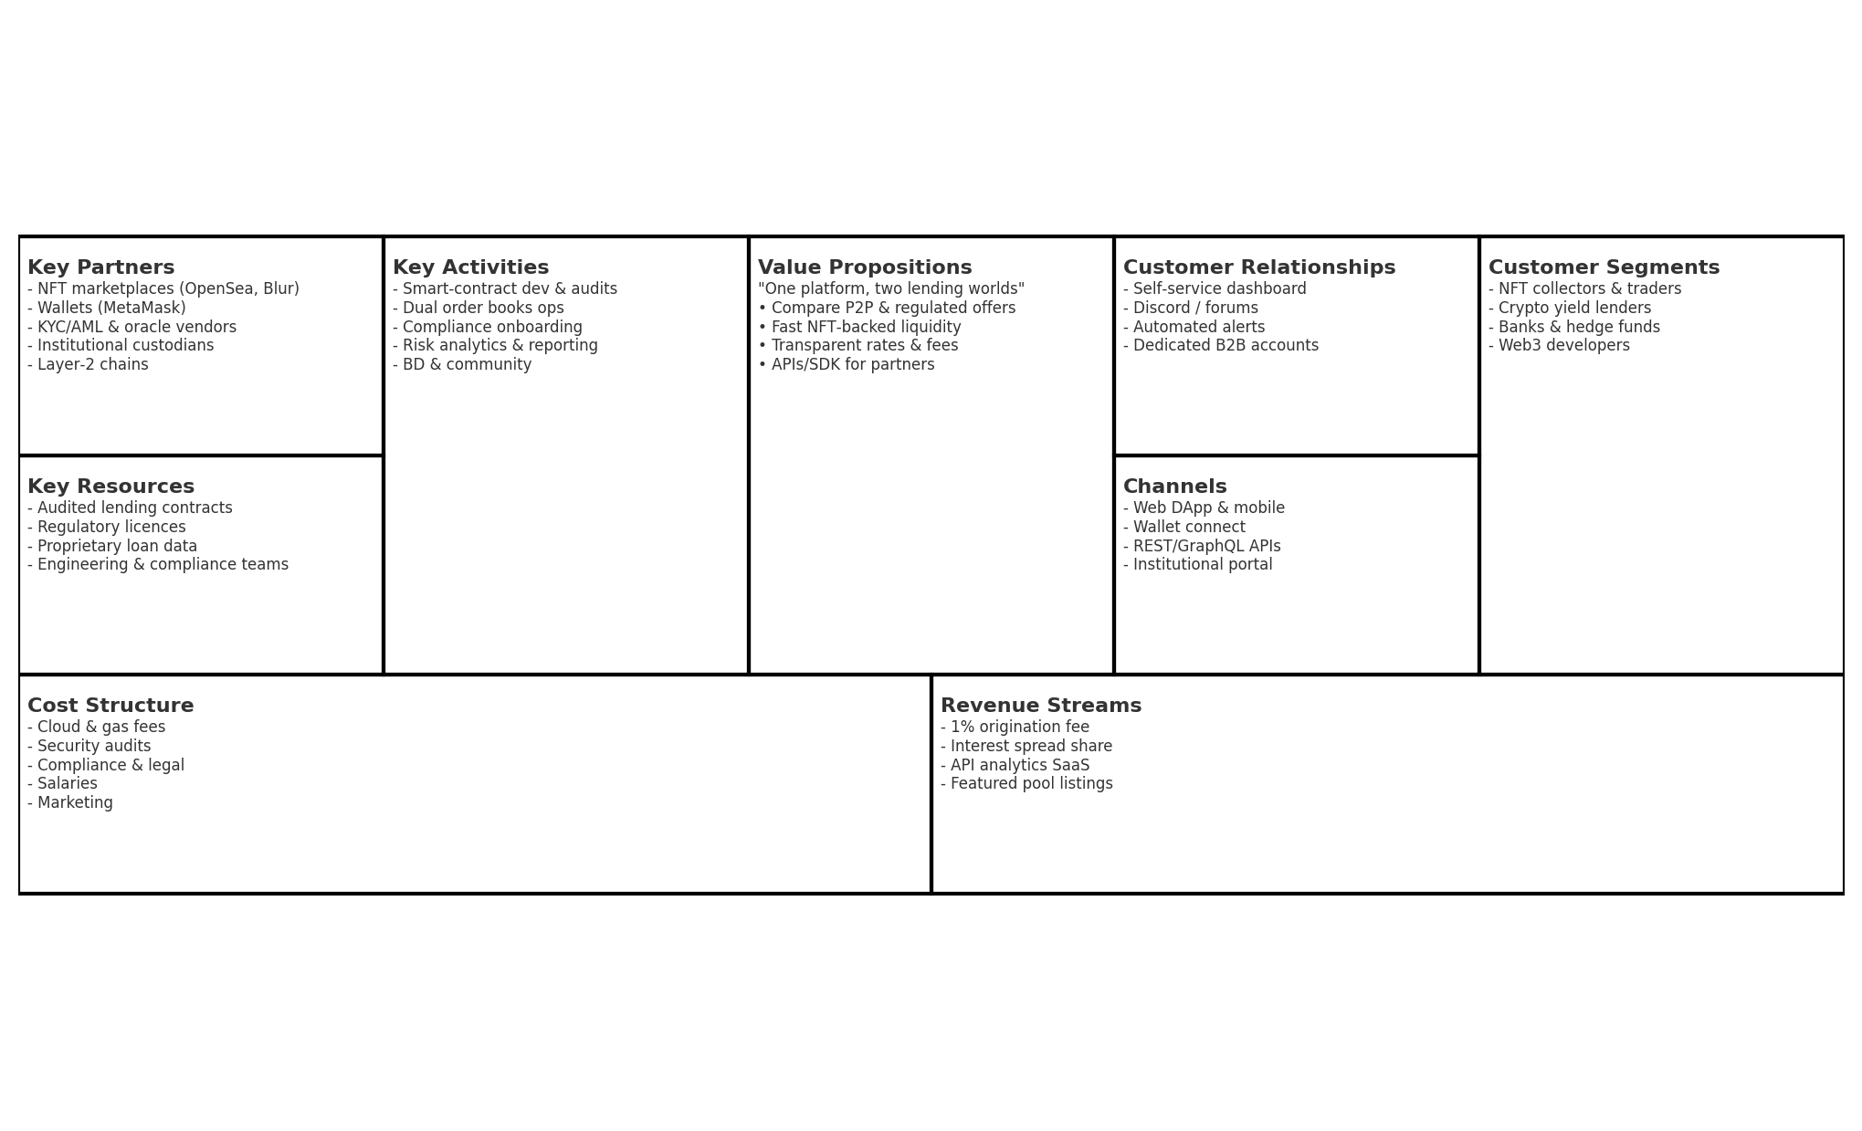
UnifyNFT - Business Model Canvas

Slide 21
05
References

Slide 22
References
[1] NFTfi. (n.d.). NFTfi: Peer-to-Peer NFT Lending Marketplace. https://nftfi.com/
[2] Figure (n,d).Fast approval & funding. https://figure.com
[3] Figure (2023). Figure Connect Overview. https://www.figure.com/newsroom/figure-technology-solutions- announces-figure-connect/
[4] Ullah, I 2025, INFO5992 Understanding IT Innovations, lecture 1,
week 3: Innovation Frameworks II: Disruptive Innovation & Innovator’s Dilemma, lecture PowerPoint slides, viewed 20 May 2025, https://canvas.sydney.edu.au/courses/63147/modules/items/2668274
[5] Ullah, I 2025, INFO5992 Understanding IT Innovations, lecture 1, week 2: Innovation Frameworks I - Dynamics of IT Innovation & Dominant Design, lecture PowerPoint slides, viewed 20 May 2025, https://canvas.sydney.edu.au/courses/63147/modules/items/2662450
[6]Musan, D.I., William, J. and Gervais, A. (2020) . NFT Finance: Leveraging Non-Fungible Tokens.
[7]Cotality (2025). Empowering Figure Technologies’ Fintech Innovation.

Slide 23
THANKS
UnifyNFT: A Unified Platform for NFT-Backed Lending
GROUP 38
21/05/2025

